Slide 1
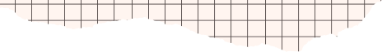


IMAGE GENERATION
FROM TEXT
USING STABLE DIFFUSION
BY ALLU ABHISHEK
NARULA INSTITUTE OF TECHNOLOGY
alluabhishek06072002@gmail.com
Mob - 6290739266

Slide 2


INTRODUCTION
“In this project, I explore generating realistic images from natural language text prompts using pre-trained diffusion models like Stable Diffusion. The system takes a user-provided description and creates a high-quality image that visually represents it, showcasing the potential of text-to-image synthesis in creative and practical applications.”

Slide 3

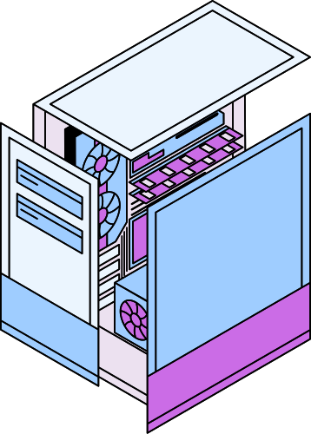

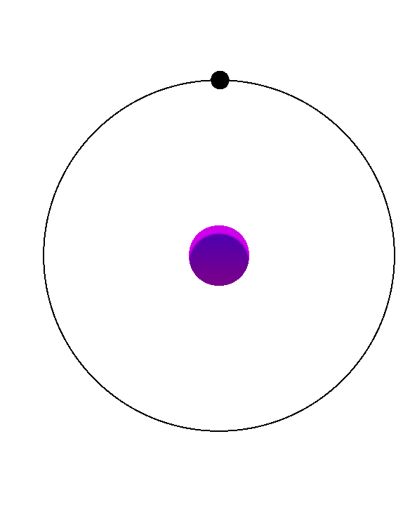
OBJECTIVES
OBJECTIVE 1
The goal was to build a system that understands textual descriptions in the form of prompts and generates corresponding visuals to nearest accuracy.
OBJECTIVE 2
This kind of work is part of the broader field of generative AI, which is increasingly important in art, design, gaming, and media. This is a part of Computer Vision.

Slide 4


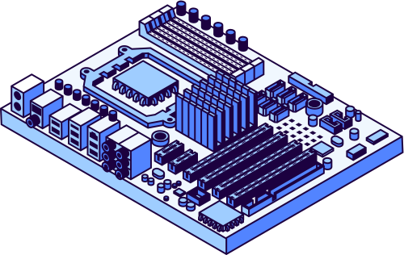

WHAT IS STABLE DIFFUSION?
Stable Diffusion is a type of deep generative model known as a latent diffusion model (LDM).
It learns to generate images by iteratively denoising random noise, guided by a given text prompt.
Unlike GANs, which generate images directly, diffusion models work in a series of gradual refinements.
Stable Diffusion is open-source, efficient, and capable of producing high-quality images from complex prompts.

Slide 5





TECHNOLOGY STACK
Python : - Used as the primary programming language for implementation.
Hugging Face diffusers library: - Provides pre-trained models and simple pipelines for working with diffusion-based models.
Google Colab was used to run the model with GPU support for faster processing.
PyTorch: Backend framework used by diffusers for model execution.
*TRANSFORMERS: USED FOR TEXT ENCODING (TURNING PROMPTS INTO EMBEDDINGS).

Slide 6



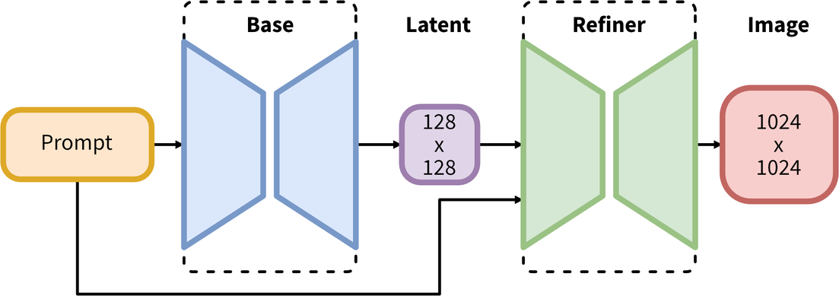
USED DIFFUSERS
stable-diffusion-xl-base-1.0
Model Description
Developed by: Stability AI
Model type: Diffusion-based text-to-image generative model
Model Description: This is a model that can be used to generate and modify images based on text prompts. It is a Latent Diffusion Model that uses two fixed, pretrained text encoders (OpenCLIP-ViT/G and CLIP-ViT/L).
dreamlike-diffusion-1.0
Model Description
Developed by: dreamlike-art
Model Type: Text-to-Image Latent Diffusion Model (based on Stable Diffusion v1.5)
Model Description: Fine-tuned for generating artistic, dreamlike, and fantasy-style images. Ideal for concept art, surreal scenes, and stylized illustrations.

Slide 7
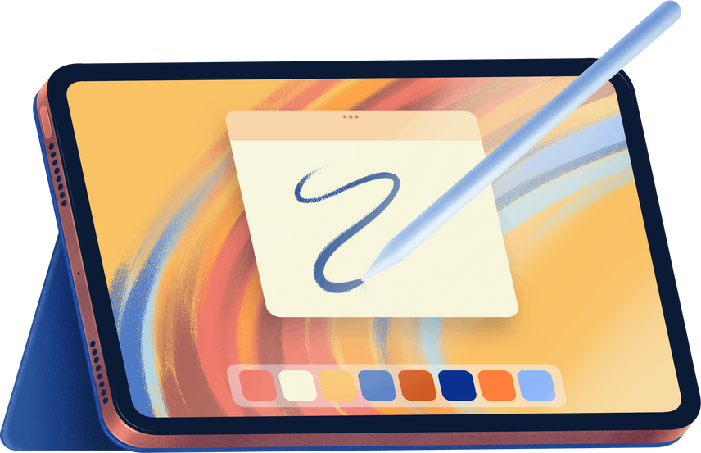
IMPLEMENTATION
WORKFLOW
Prompt is taken from the user as input.
The StableDiffusionPipeline is loaded using the diffusers library with appropriate configurations (e.g., float32 for CPU inference).
The model processes the prompt and returns an image as output.
The image is then displayed and saved using PIL.

Slide 8
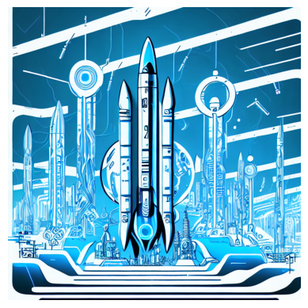
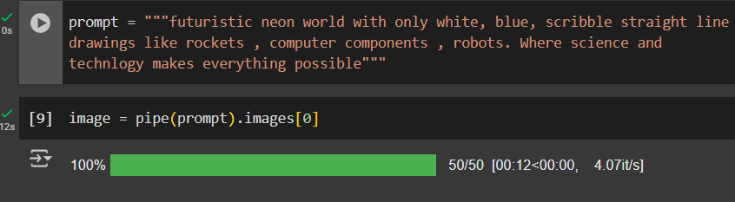
IMPLEMENTATION
WORKFLOW
INPUT TEXT PROMPT
OUTPUT IMAGE

Slide 9
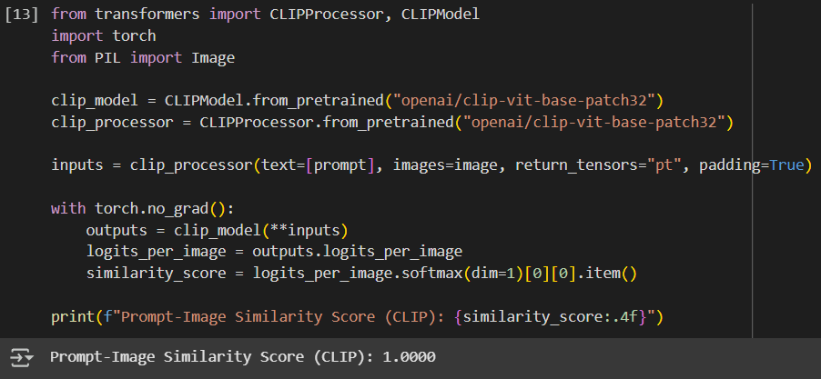
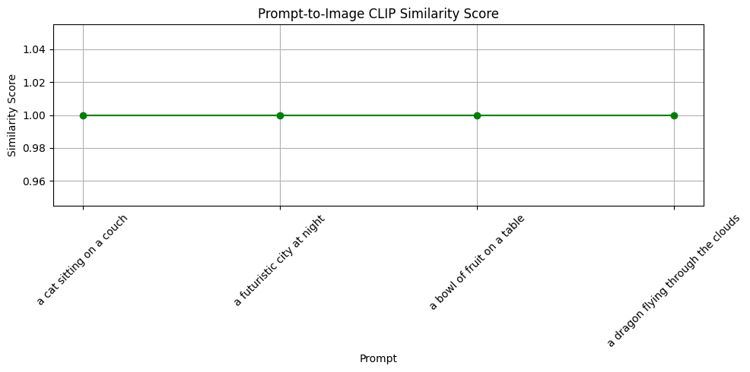
RESULTS
A CLIP score is a metric used to assess the compatibility between an image and a textual description. It quantifies how well the image matches the text, with higher scores indicating a better match. A higher score (close to 1.0) means better prompt-image alignment.

Slide 10


Challenges
Managing high memory requirements, especially when working without a GPU.
Optimizing for float32 precision to allow compatibility with CPU-based systems.
Ensuring prompt sensitivity and repeatable results for consistent user experience.

Slide 11

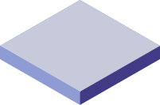

CONCLUSIONS
CONCLUSION 1
CONCLUSION 3
By integrating Hugging Face’s diffusers library with Python, we successfully created a functional and efficient text-to-image generation tool.
This project demonstrates the capabilities of modern AI models in generating creative visual content from natural language.
CONCLUSION 2
This opens doors to future enhancements like prompt refinement, style control, and GUI/web integration.

Slide 12

THANK YOU

